Slide 1
effectiveskiing.com
effectiveskiing.com
☑✔
☒✖

Slide 2
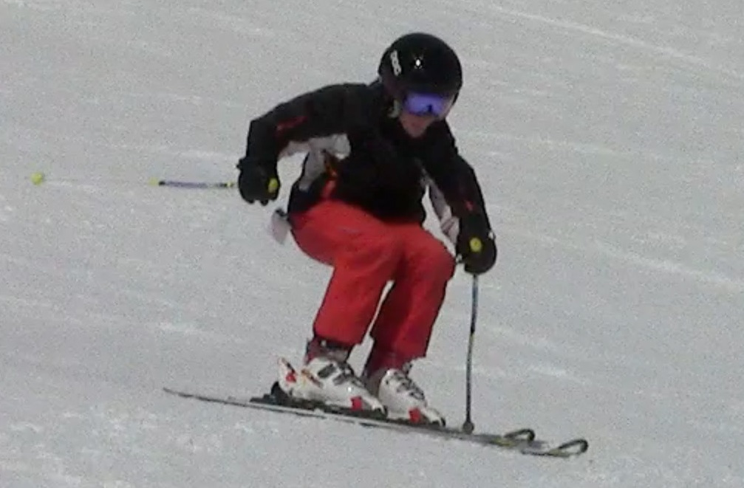
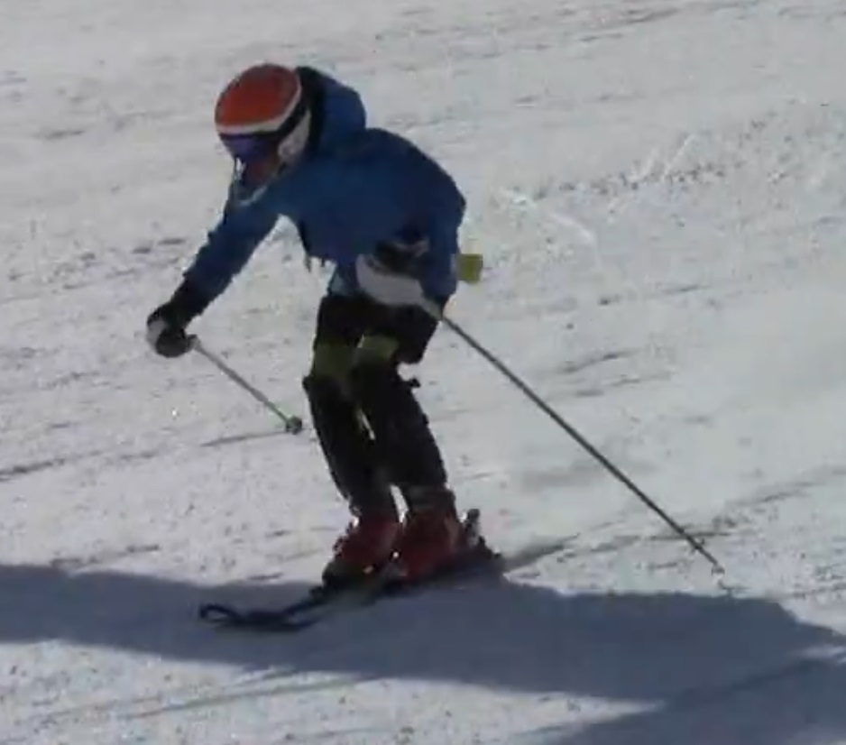
✔
✖
effectiveskiing.com

Slide 3
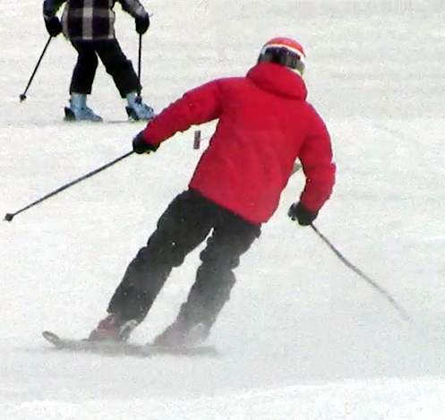
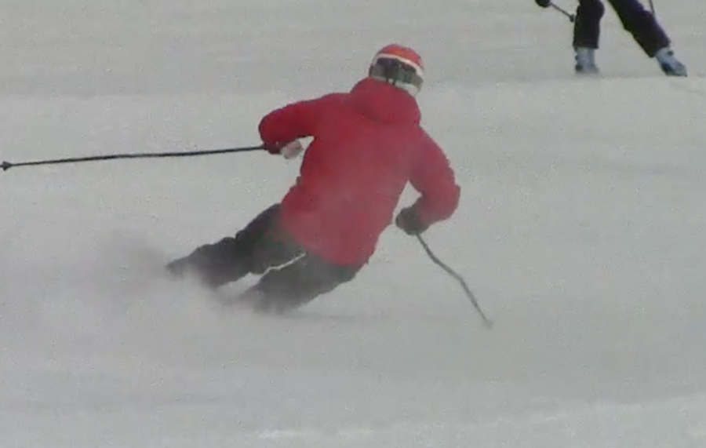

Slide 4
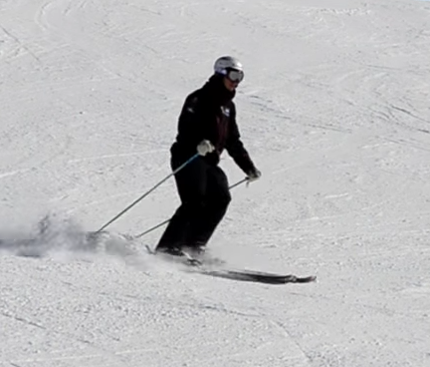
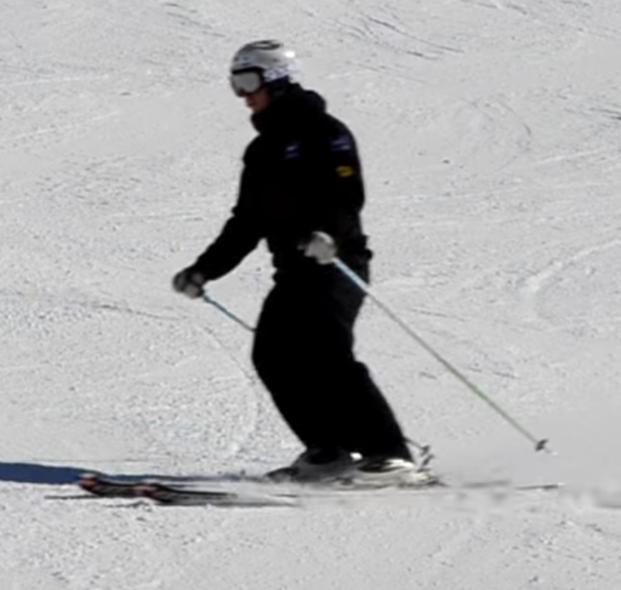
✖
Rotation
effectiveskiing.com

Slide 5
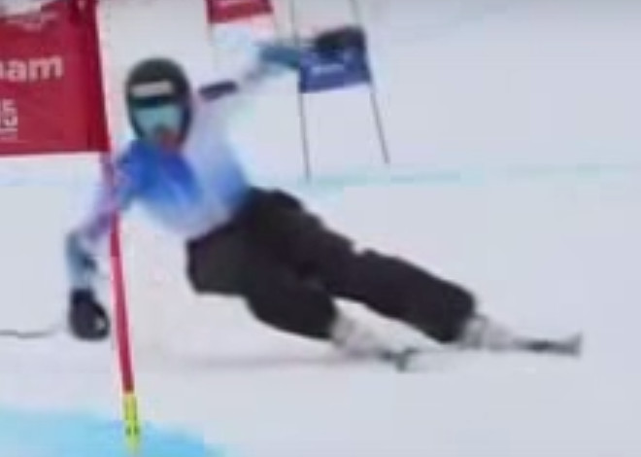
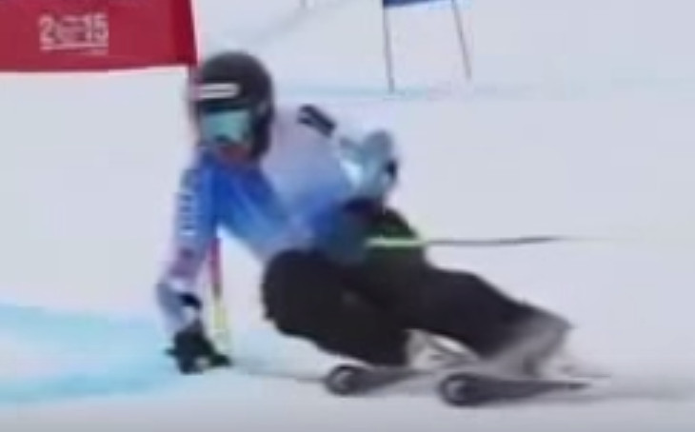

Slide 6
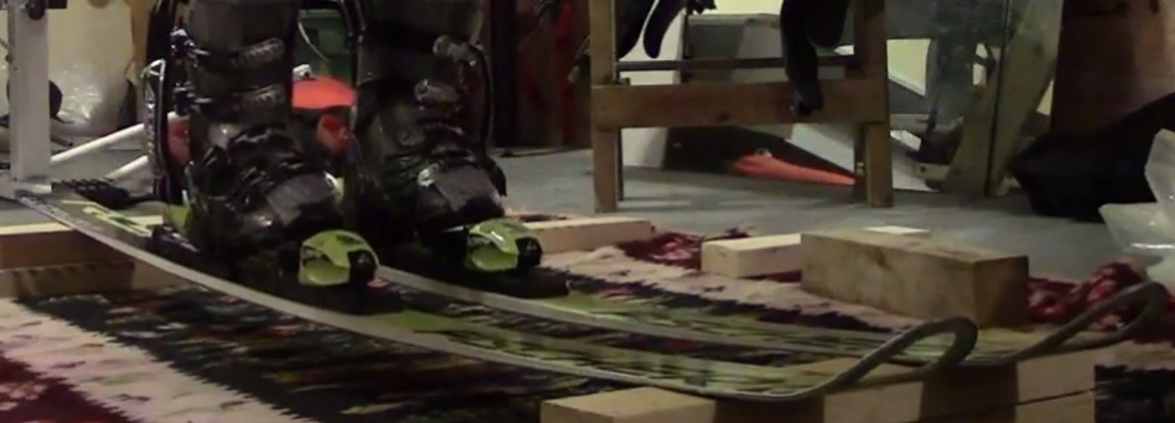
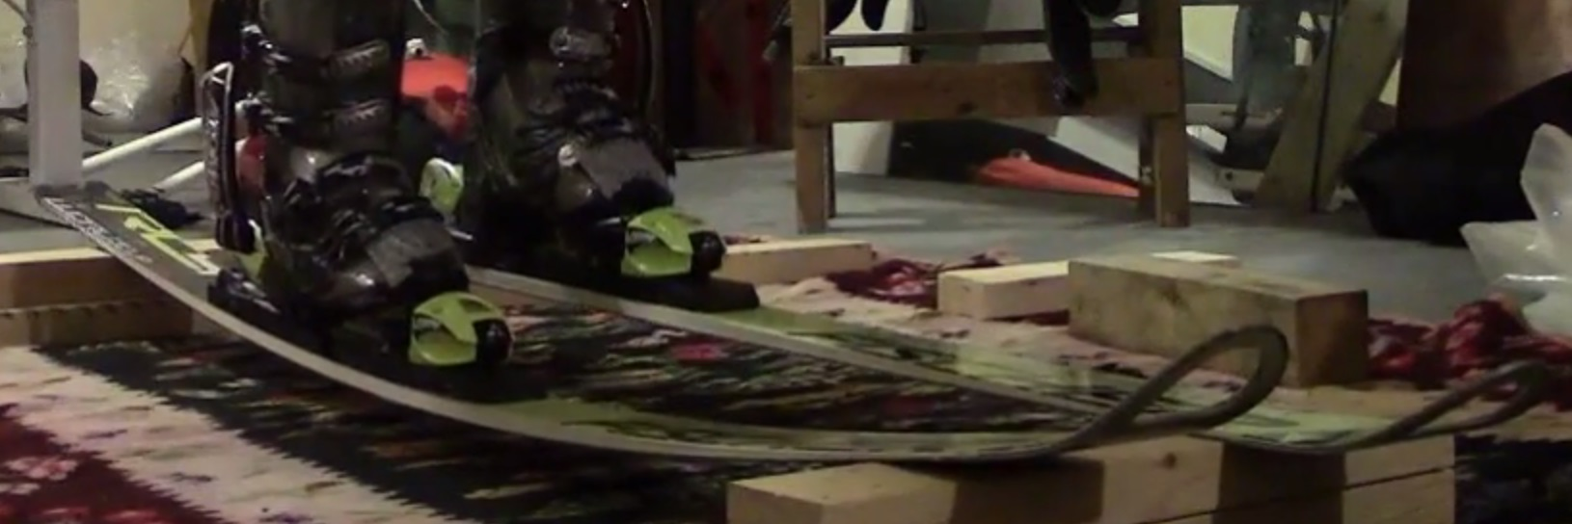
effectiveskiing.com

Slide 7
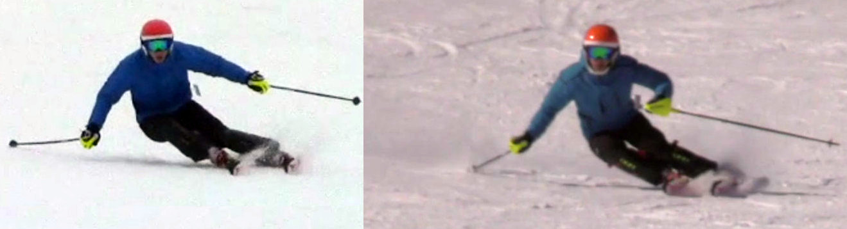
effectiveskiing.com

Slide 8
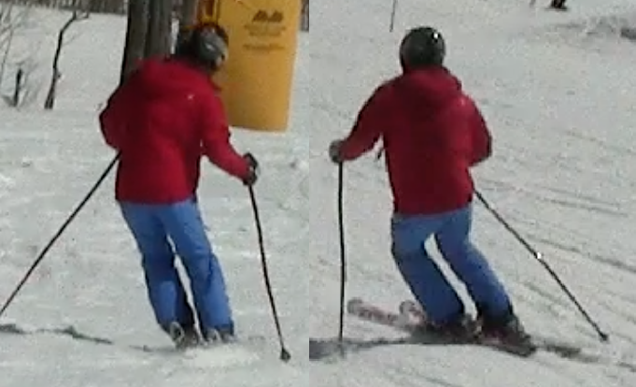
effectiveskiing.com
4
2
1
3

Slide 9
effectiveskiing.com
CA
CB
TIP
TURN

Slide 10
effectiveskiing.com

Slide 11
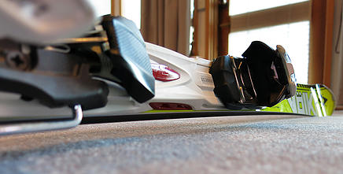
TIPPING
PUSHING
EffectiveSkiing.com

Slide 12
TIPPING
(edging)
EffectiveSkiing.com

Slide 13
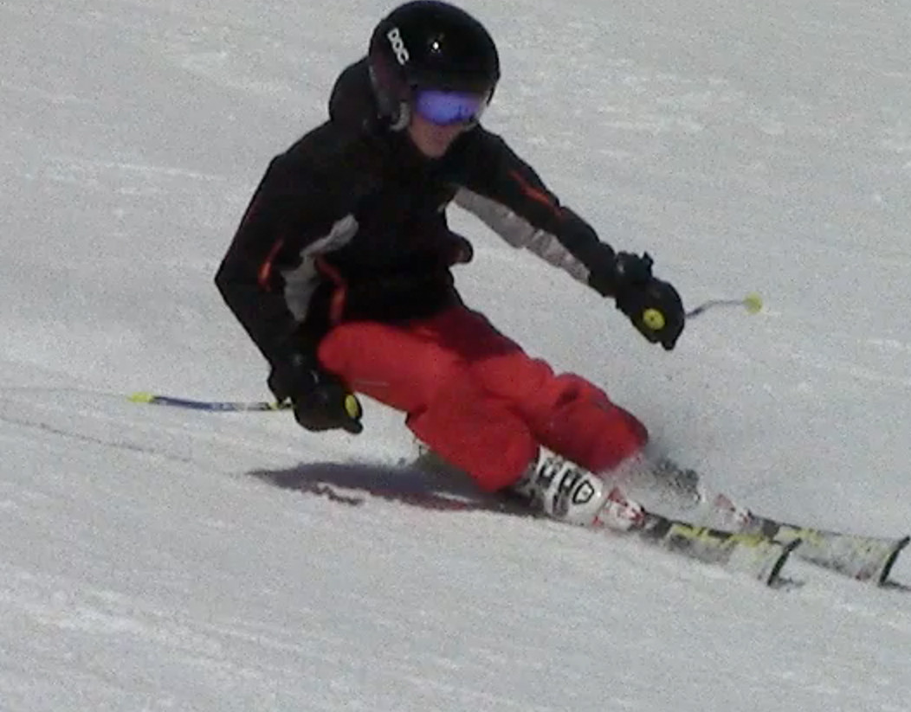
effectiveskiing.com

Slide 14
effectiveskiing.com

Slide 15
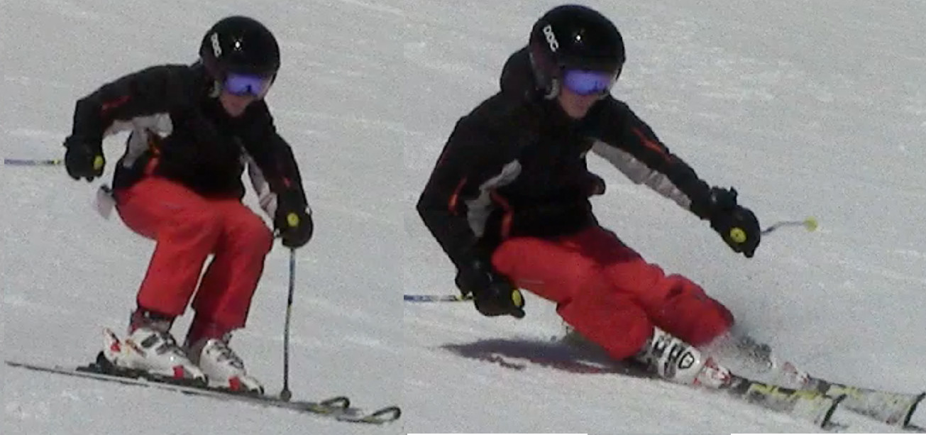
effectiveskiing.com

Slide 16
effectiveskiing.com

Slide 17
effectiveskiing.com

Slide 18
effectiveskiing.com

Slide 19
effectiveskiing.com

Slide 20
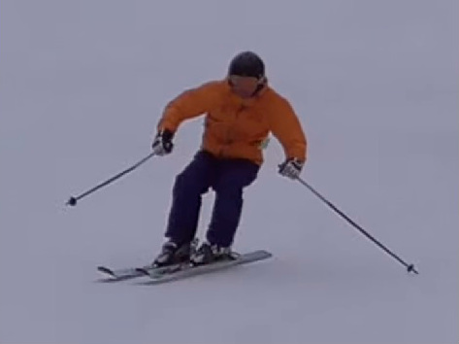
effectiveskiing.com

Slide 21
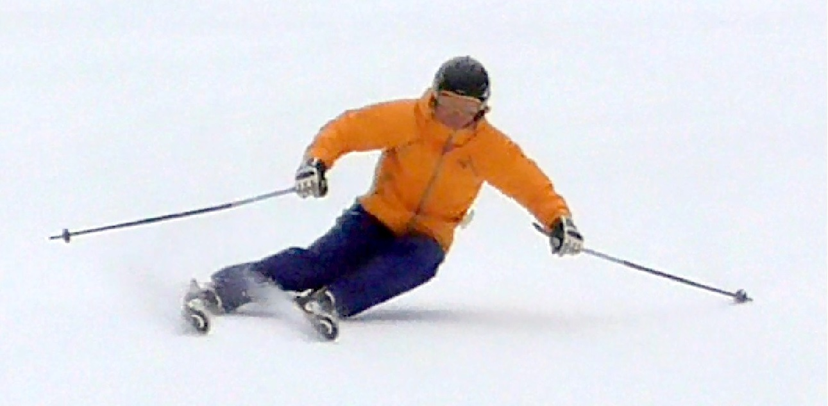
effectiveskiing.com

Slide 22
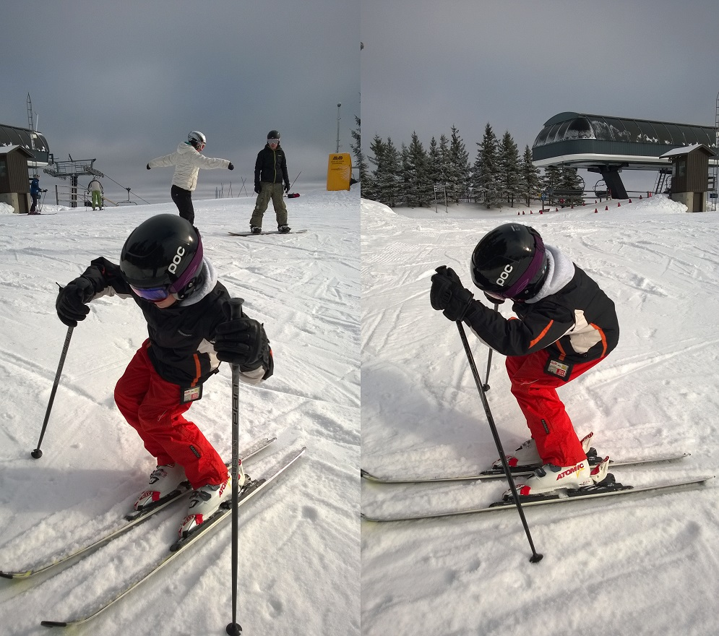
effectiveskiing.com

Slide 23
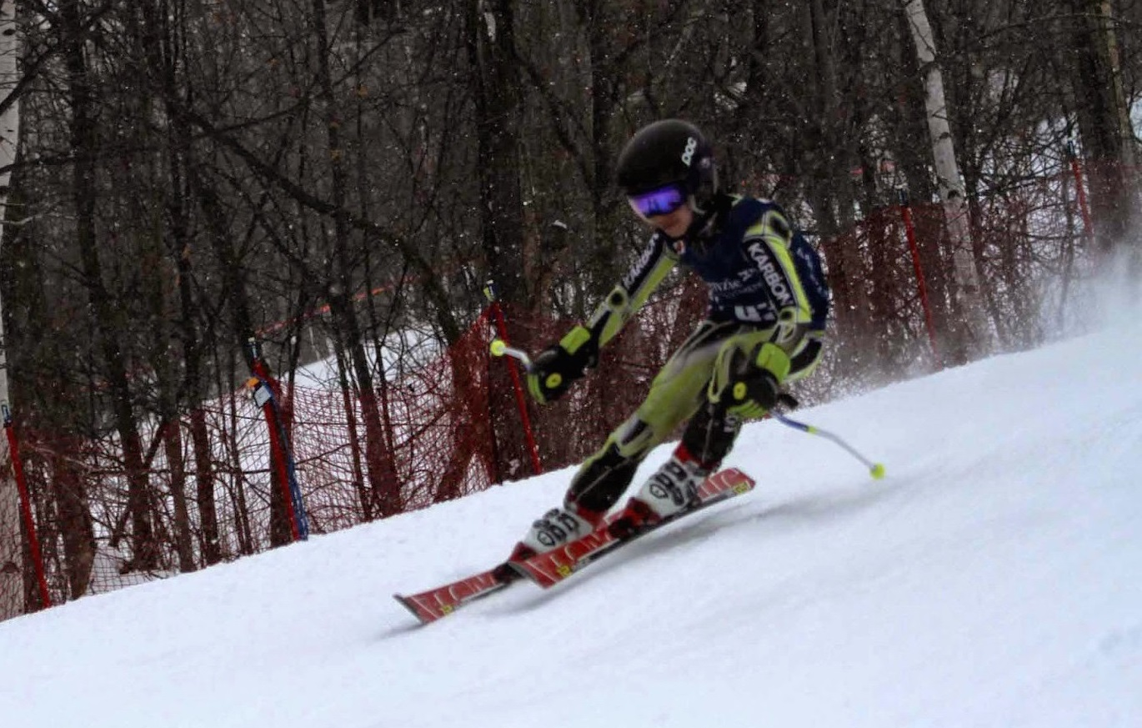
effectiveskiing.com

Slide 24
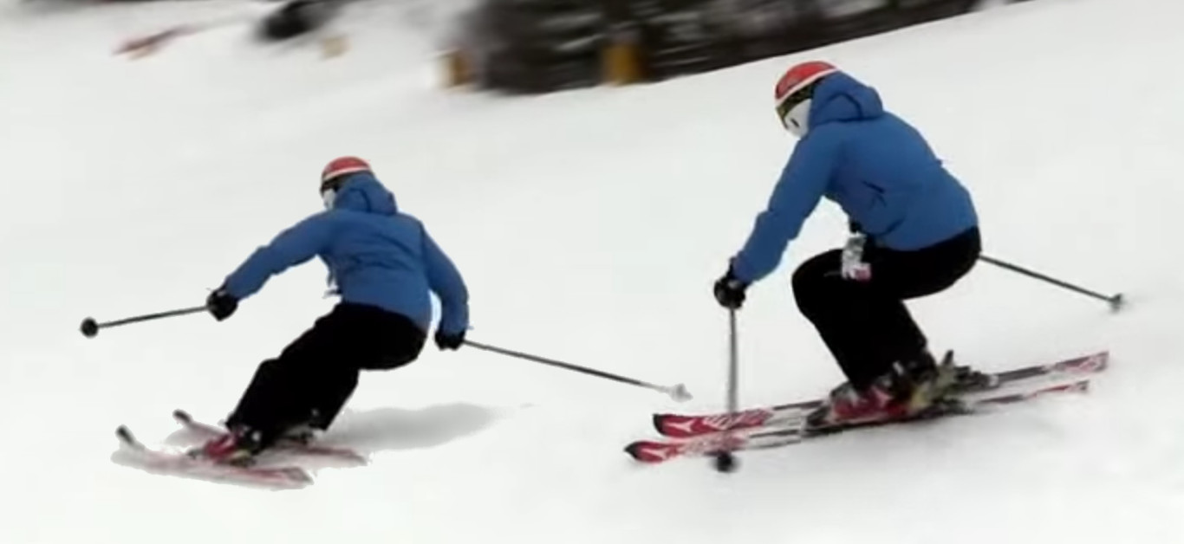
EffectiveSkiing.com

Slide 25
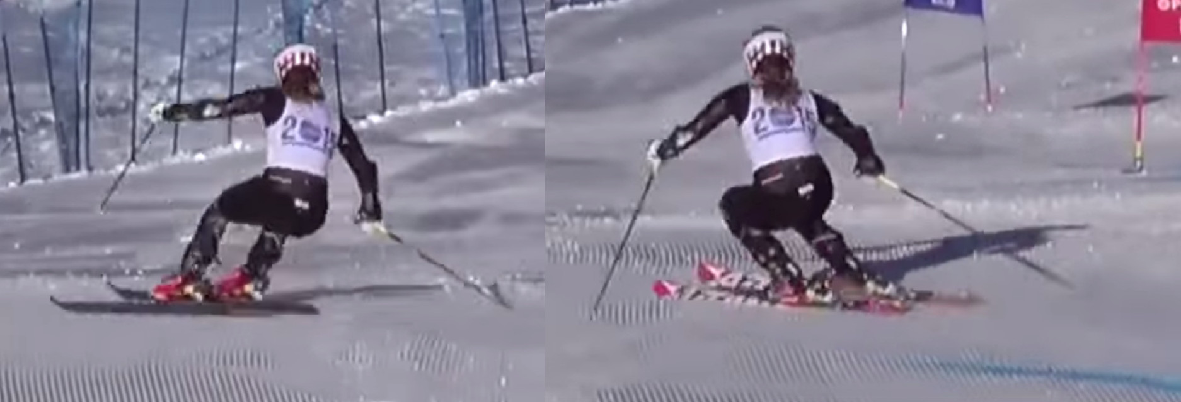
EffectiveSkiing.com

Slide 26
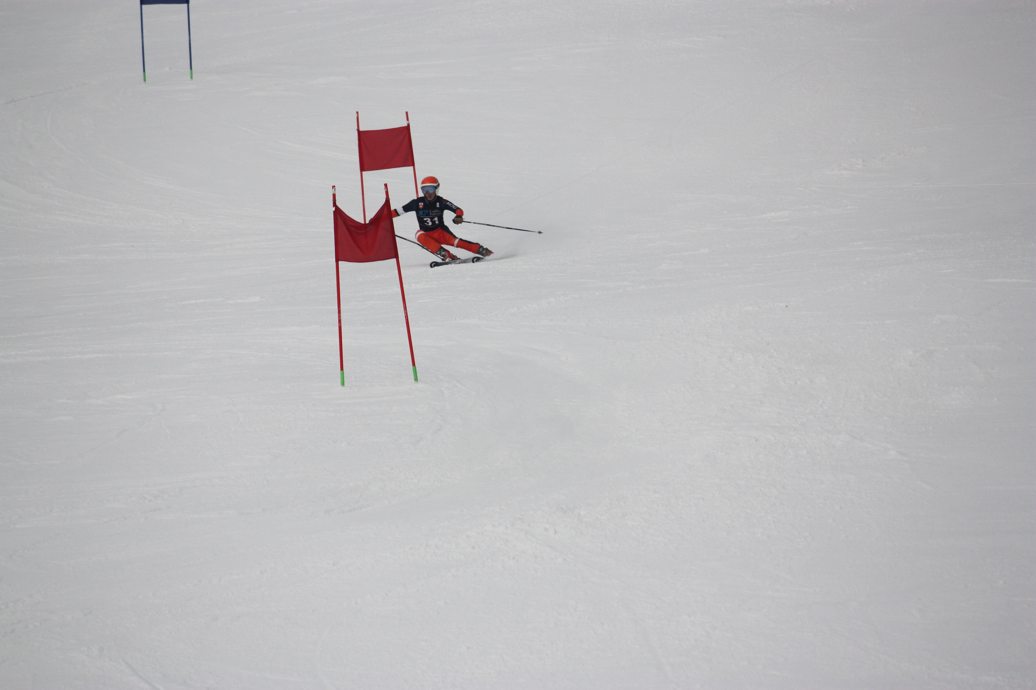
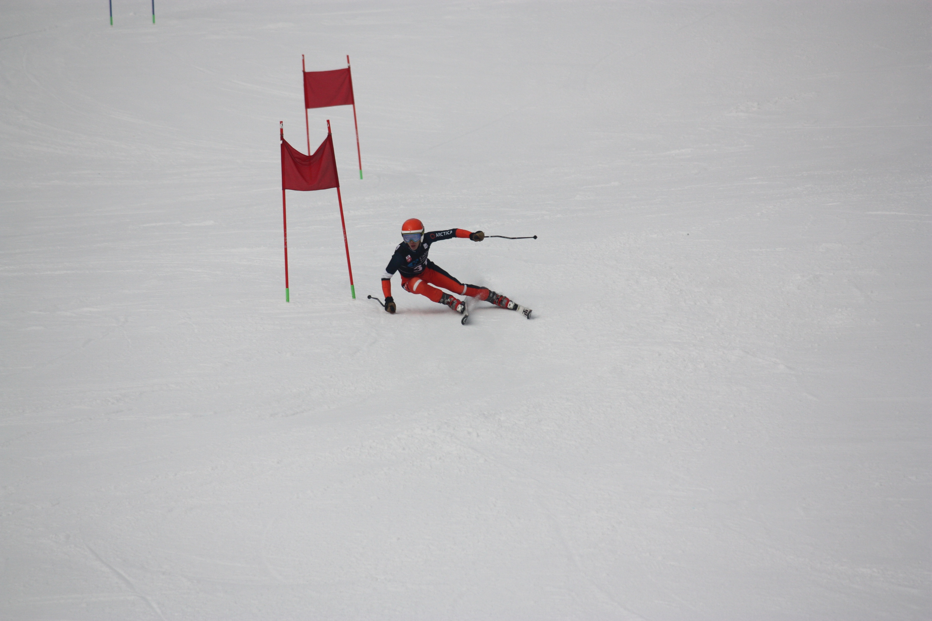
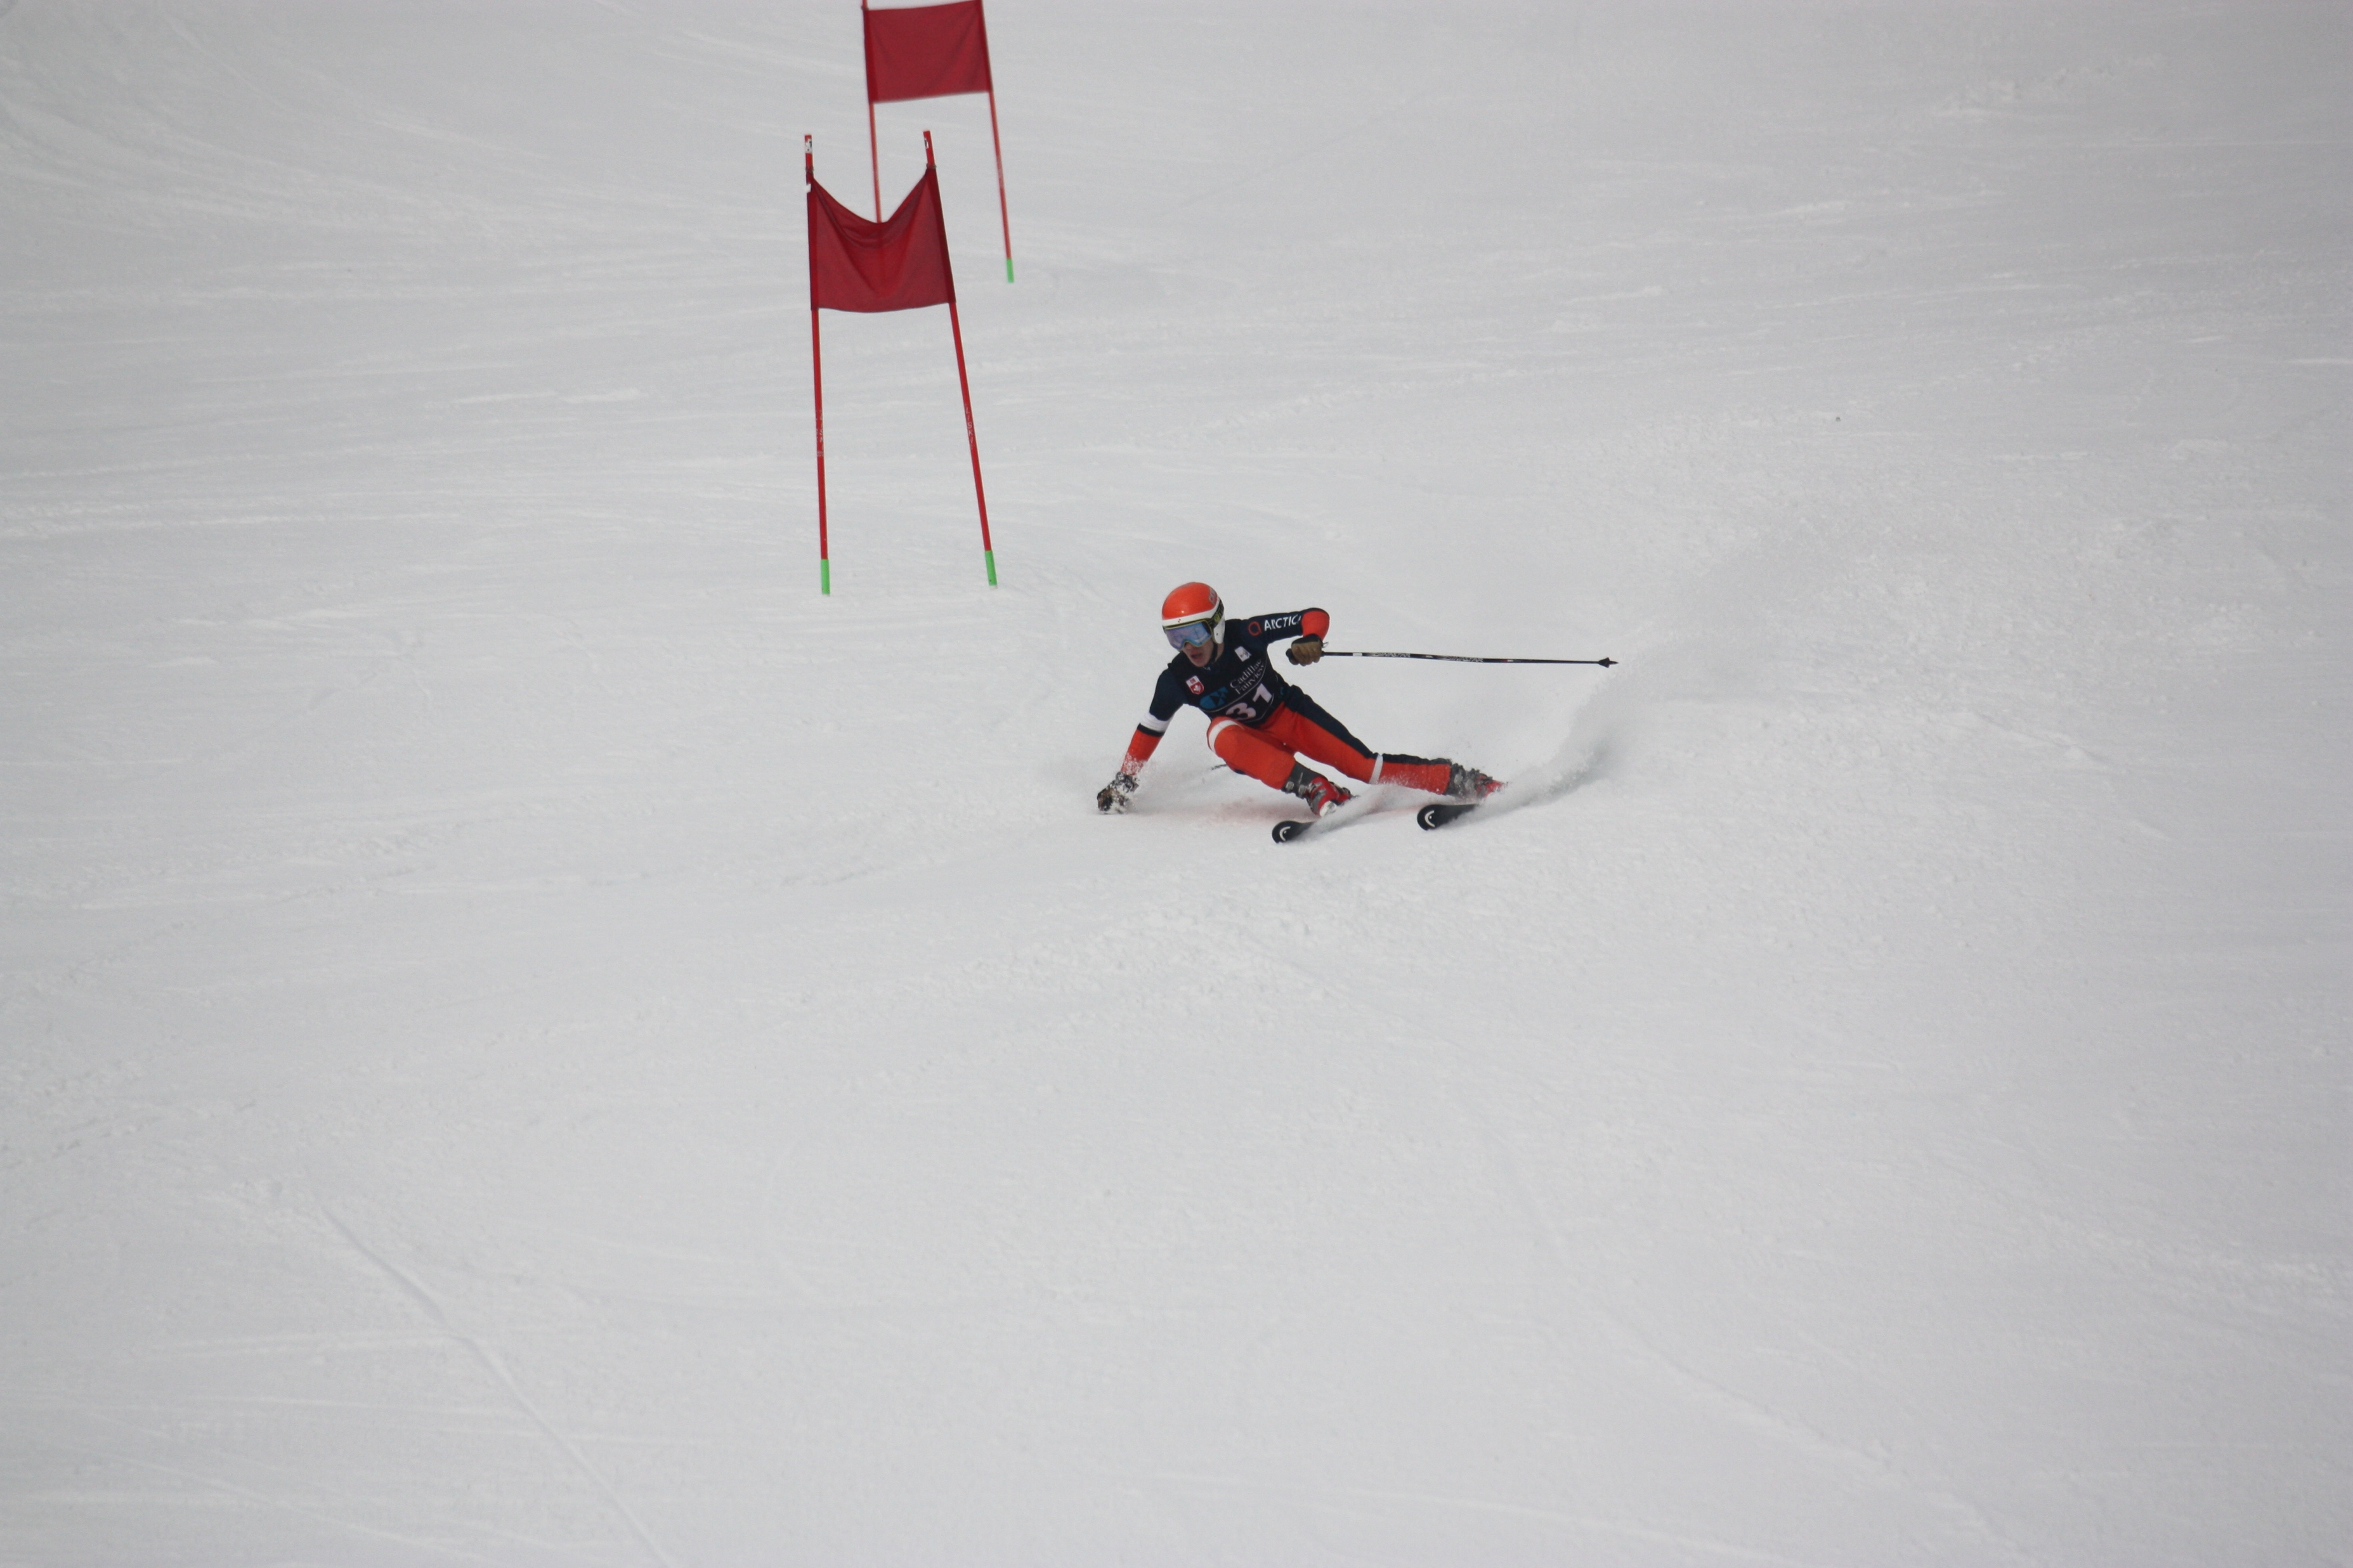
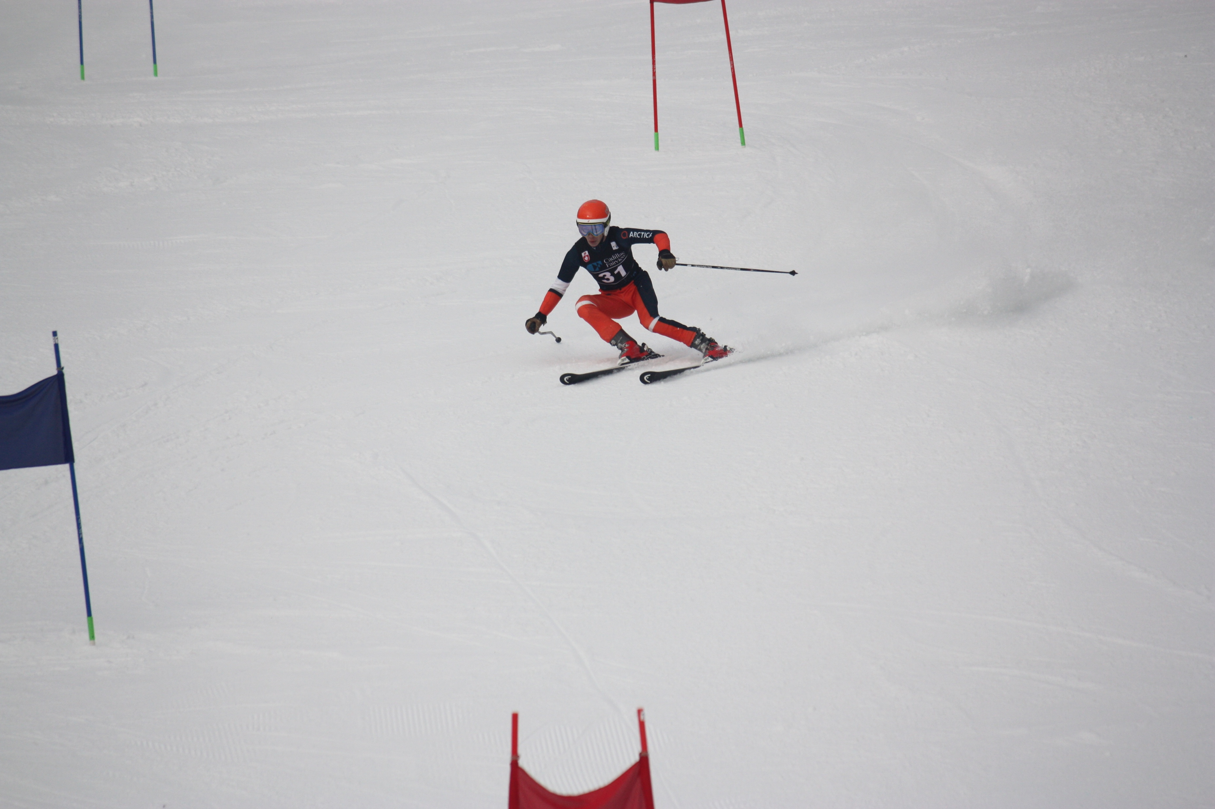
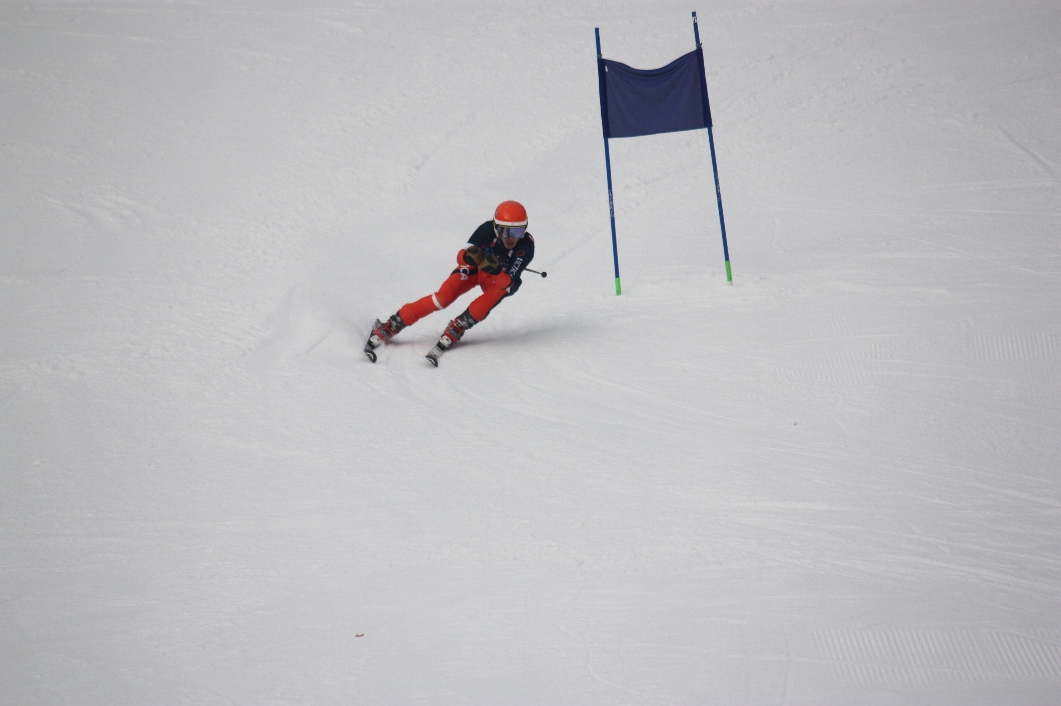
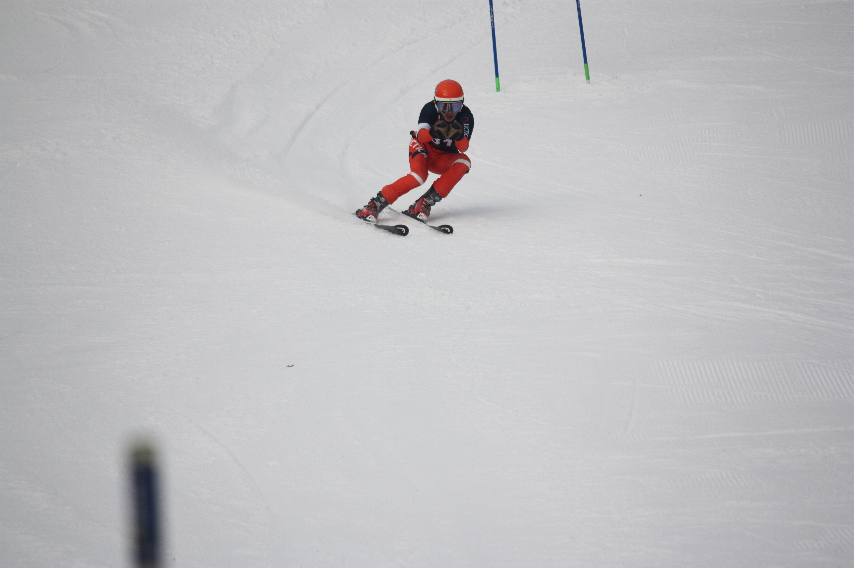
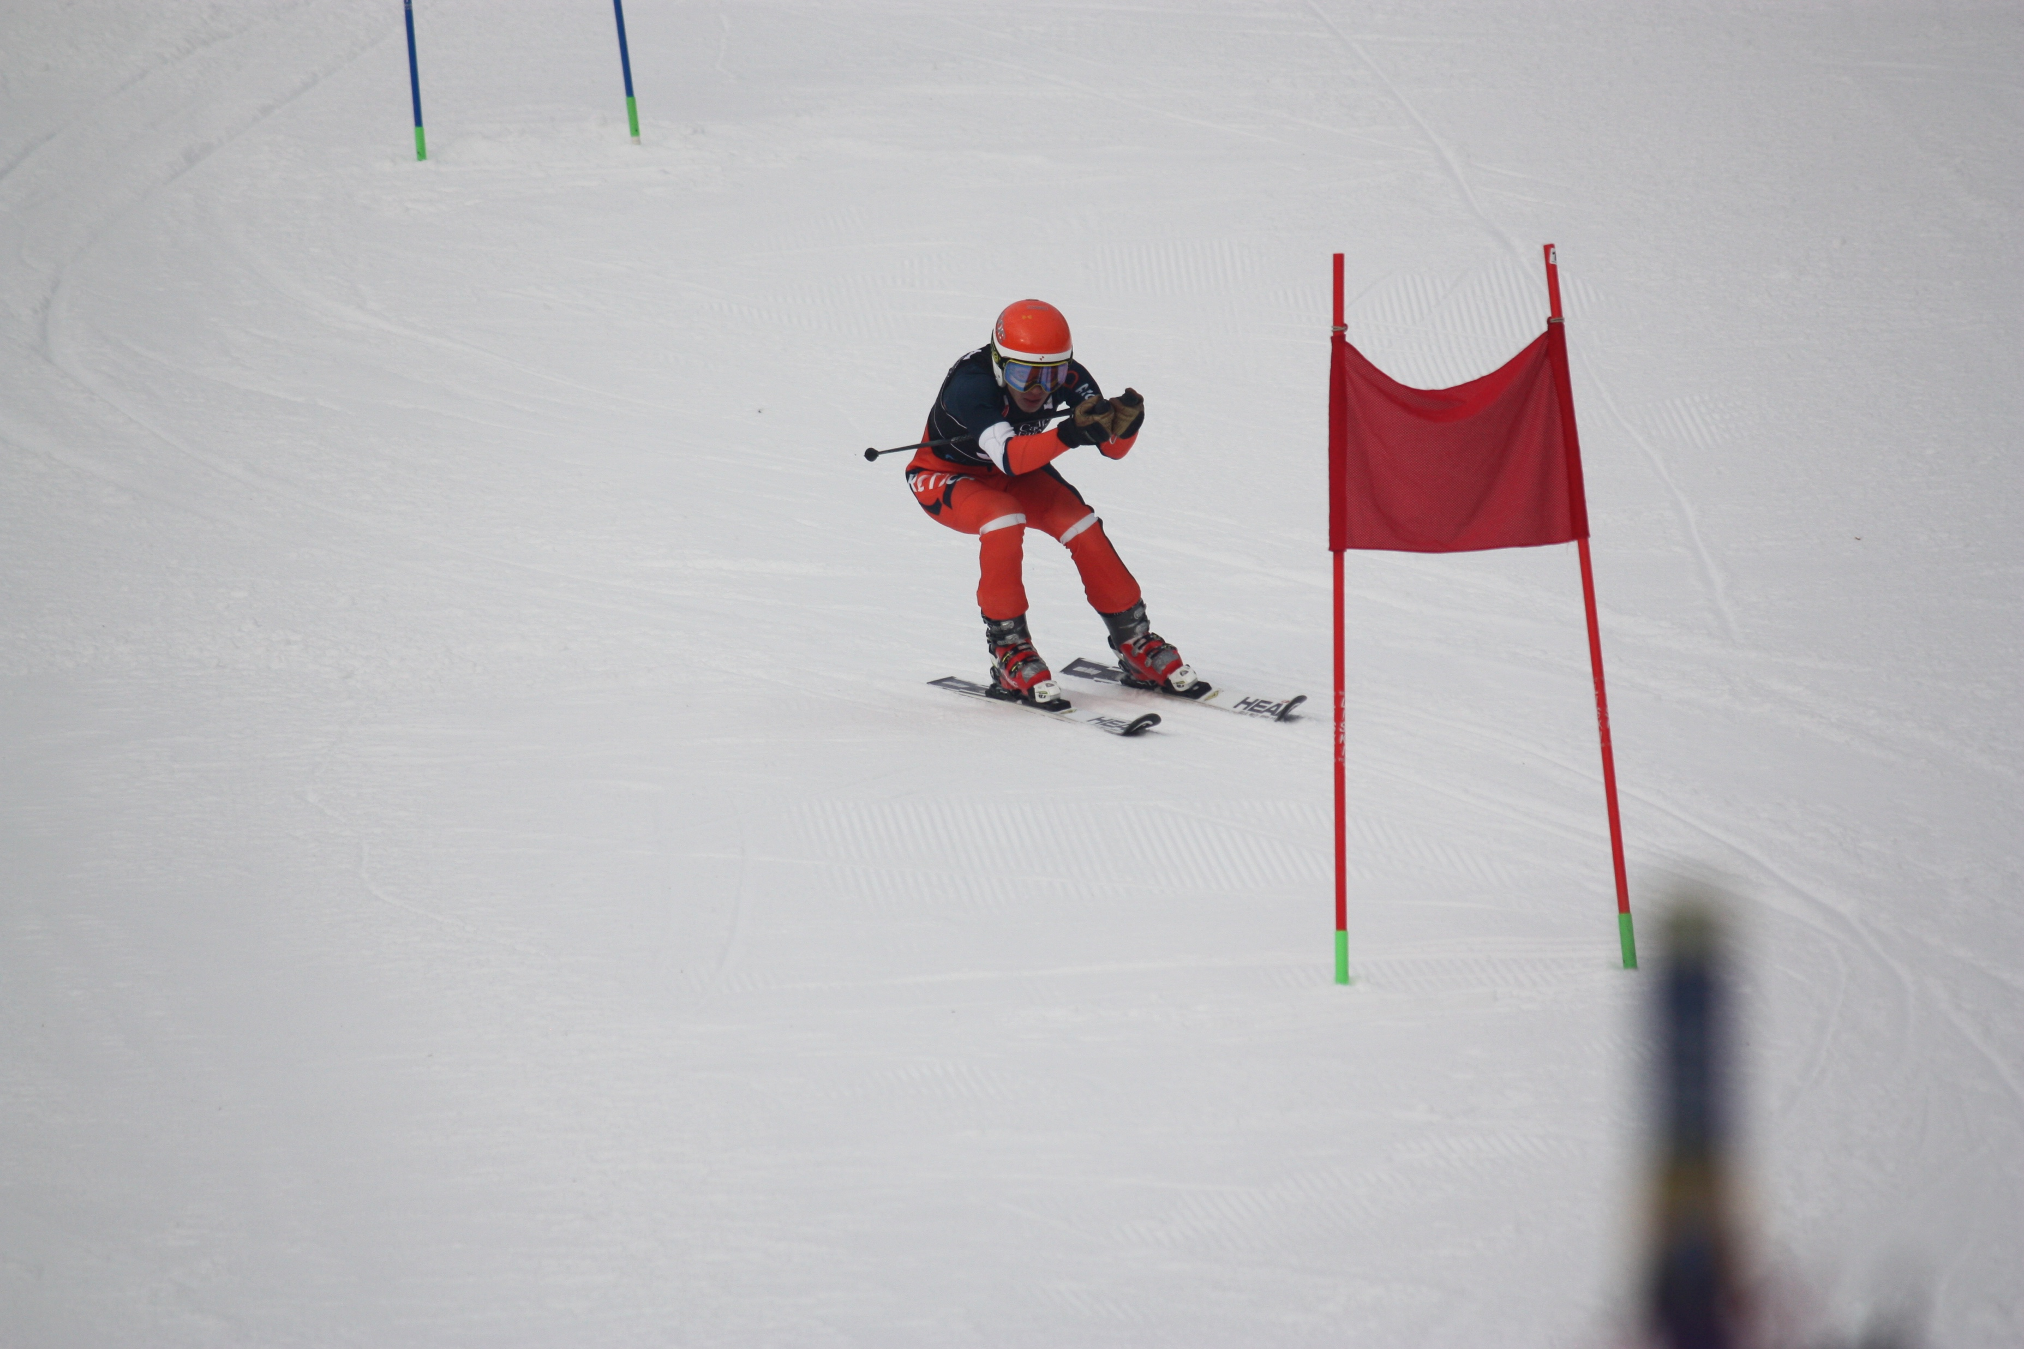
1
2
4
3
5
6
EffectiveSkiing.com

Slide 27
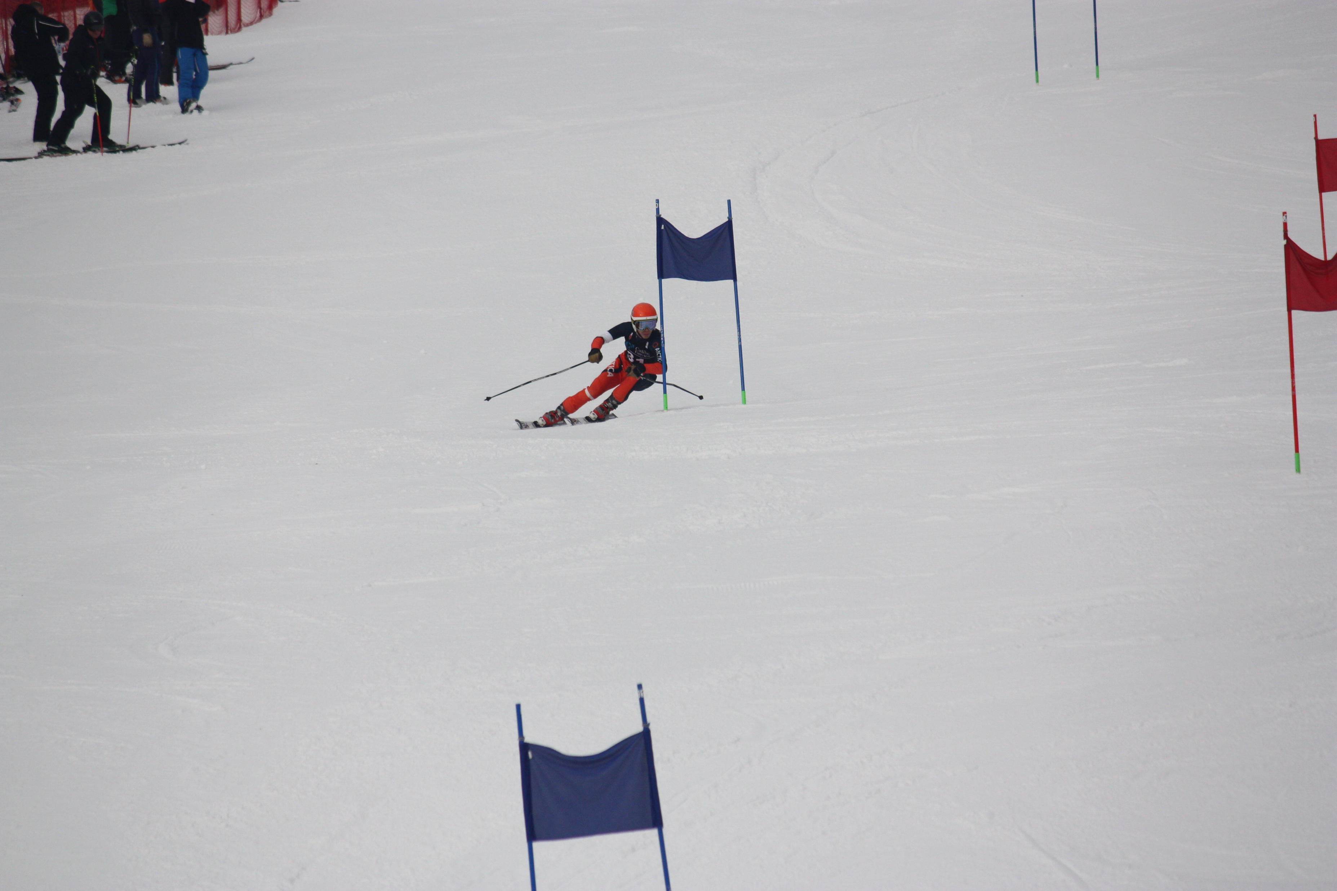
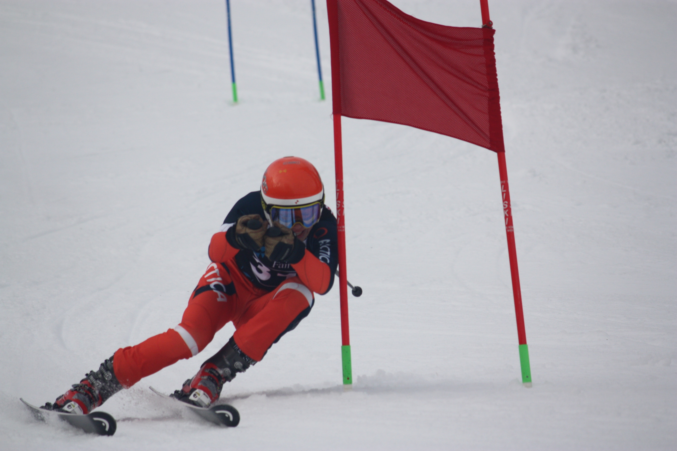
EffectiveSkiing.com

Slide 28
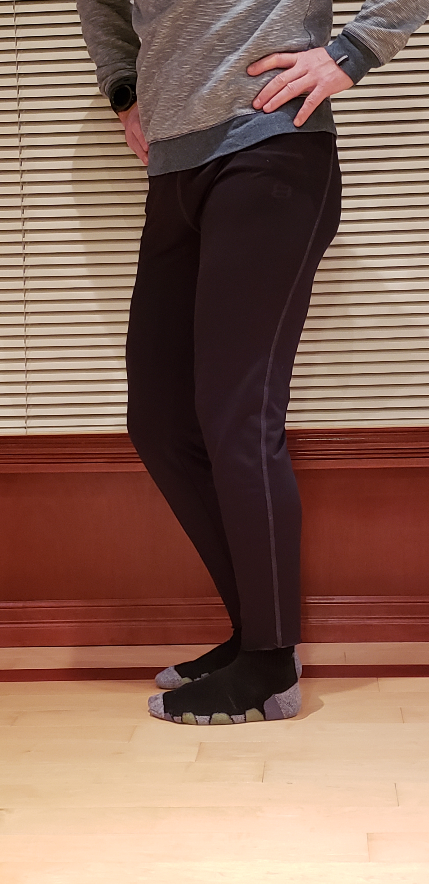
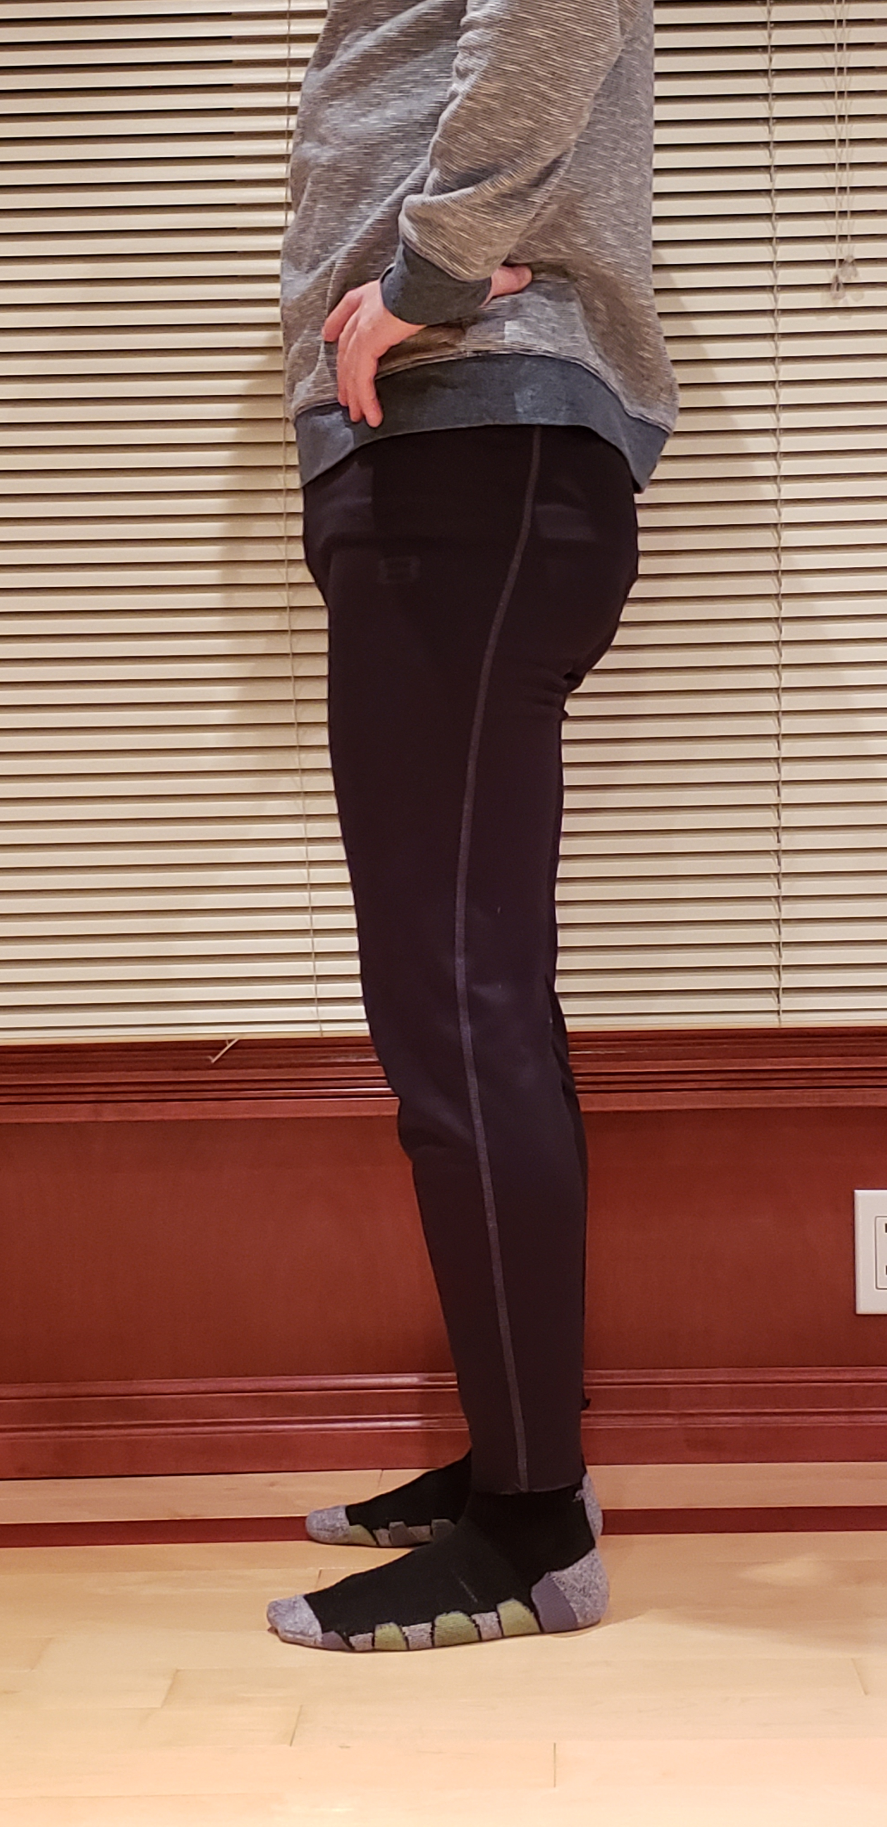
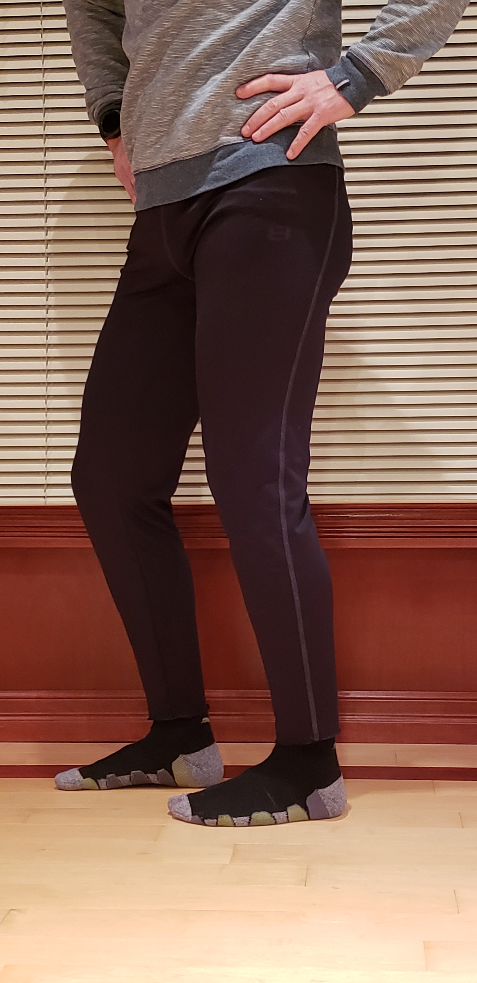
c
a
b
EffectiveSkiing.com

Slide 29
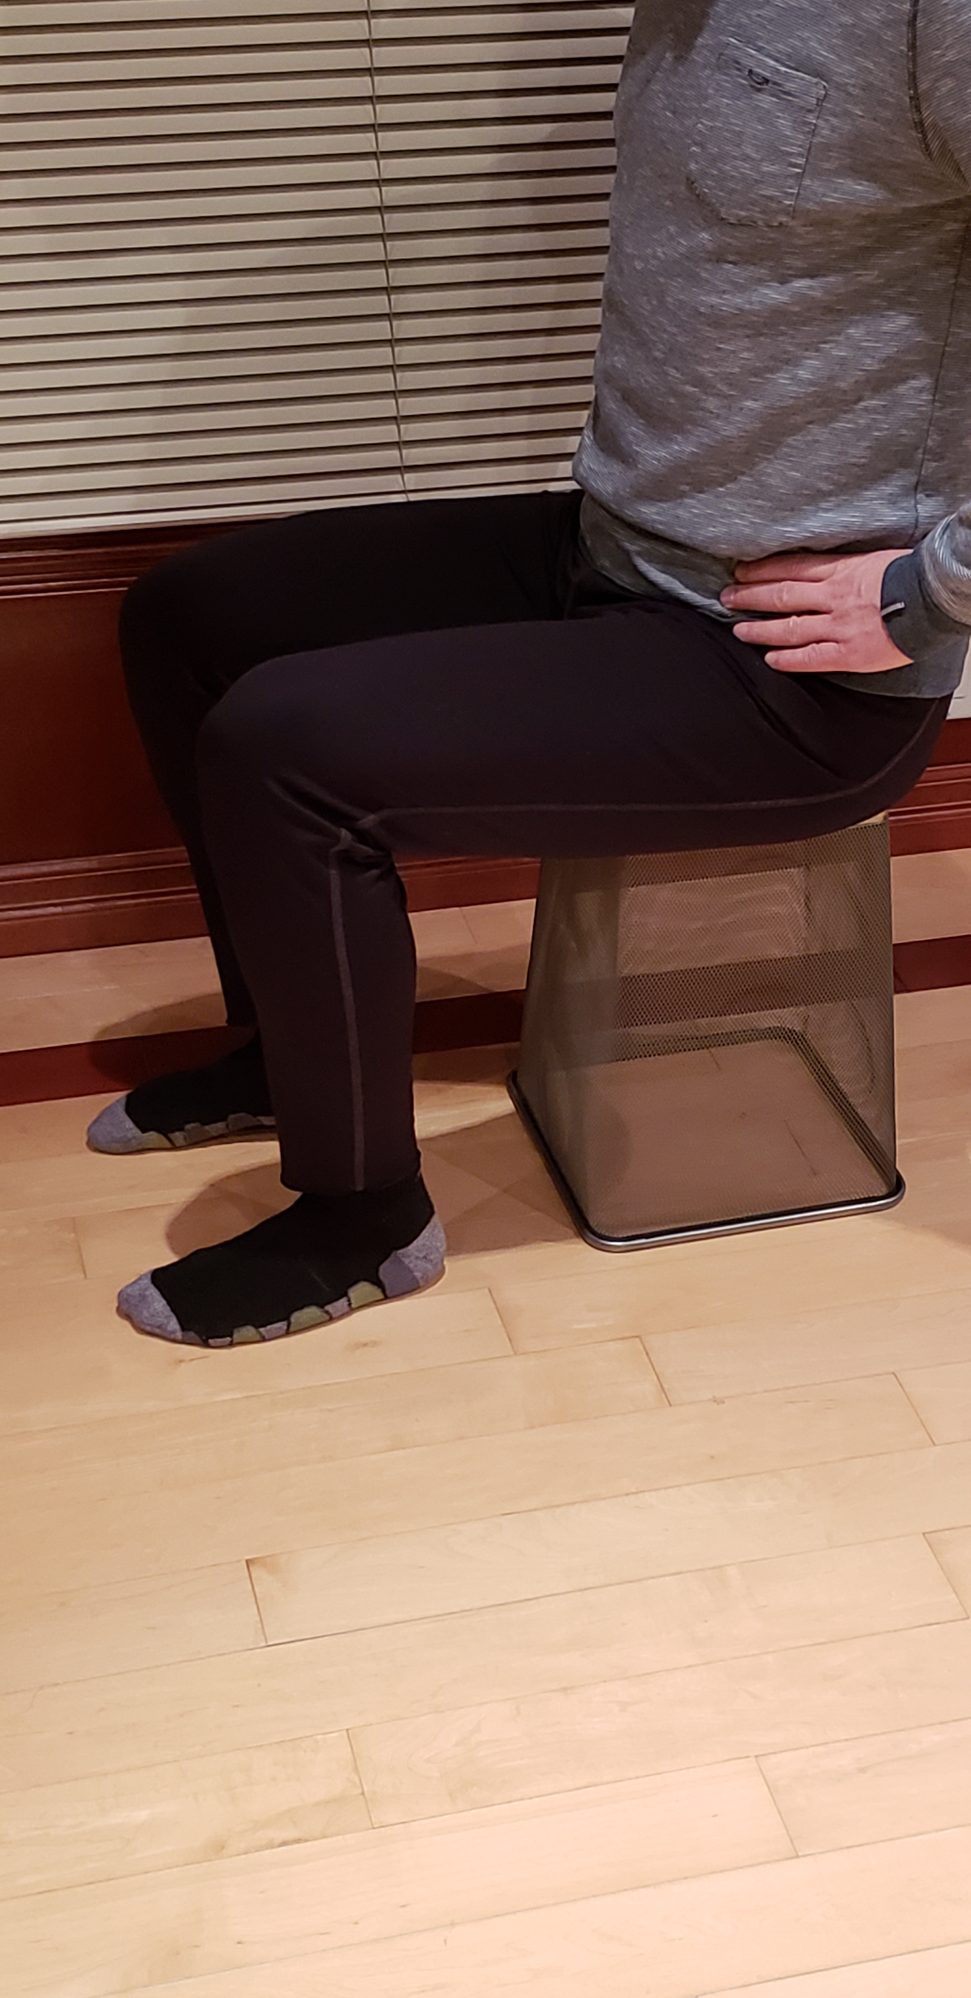
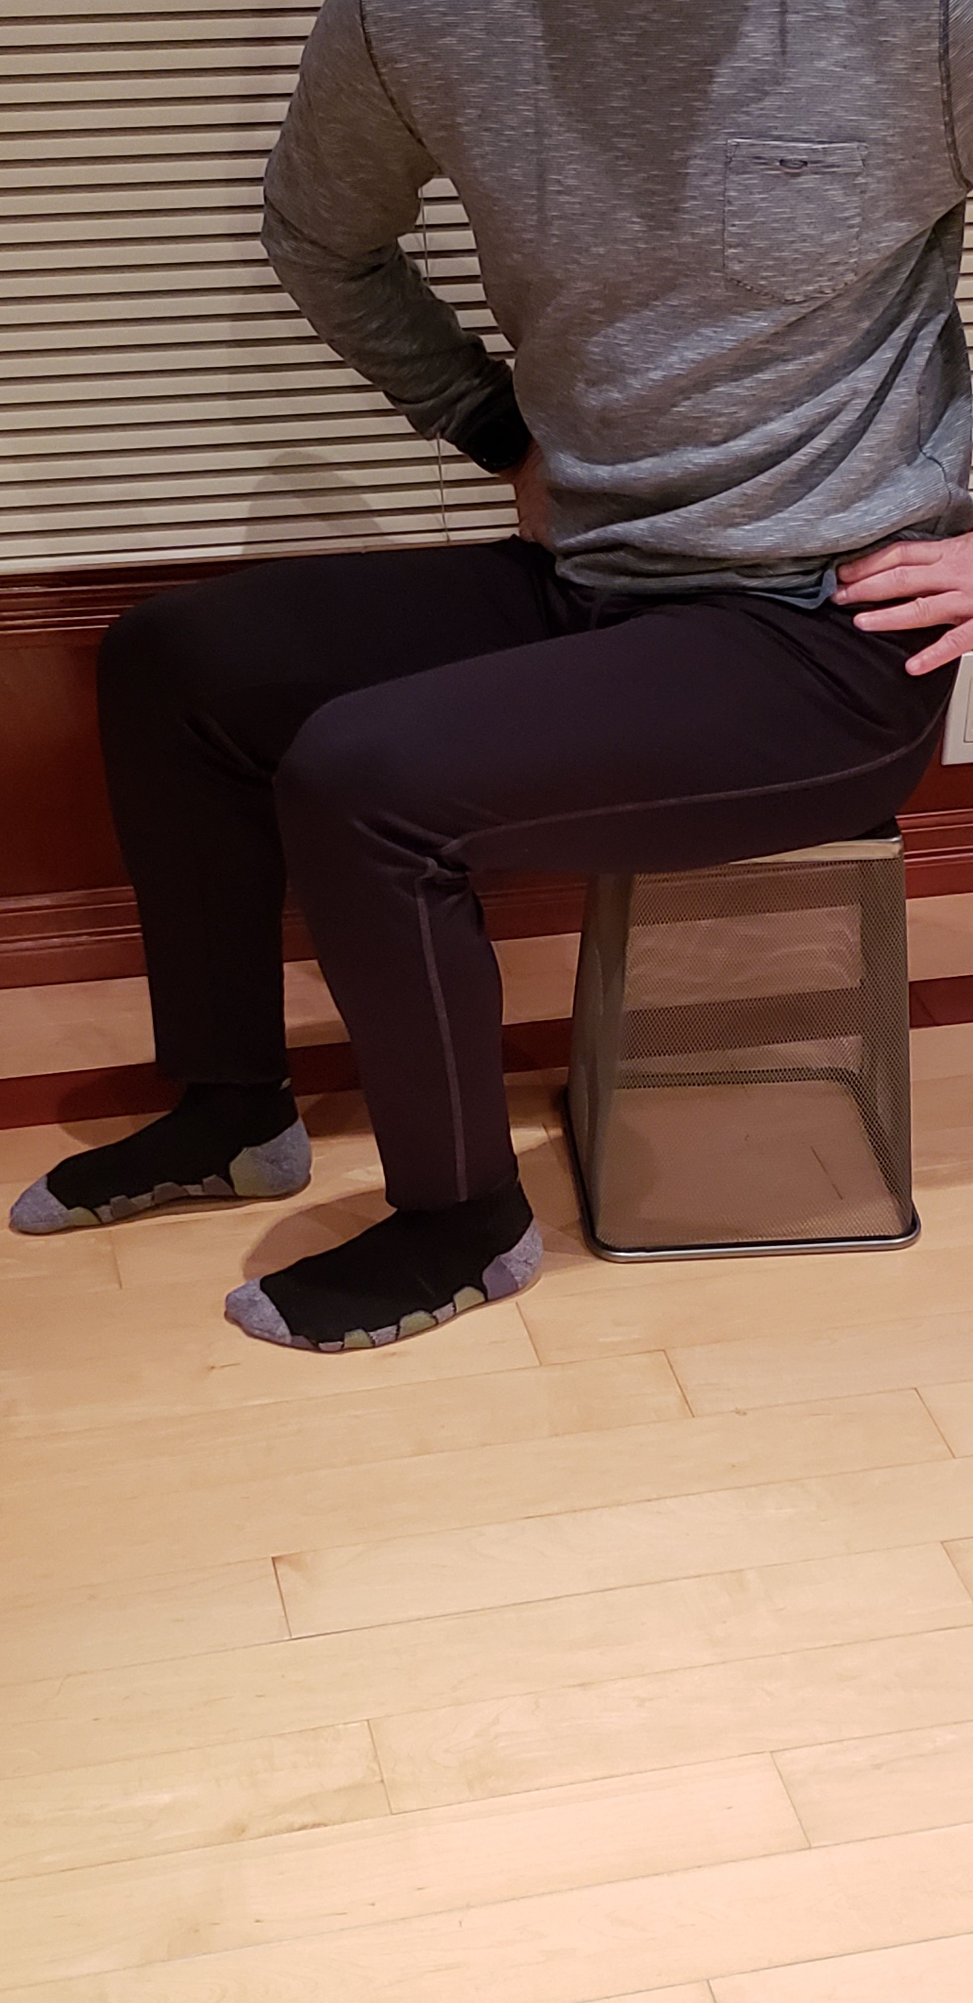
b
a
EffectiveSkiing.com

Slide 30
